Slide 1
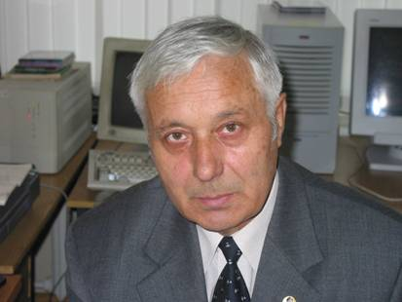
Academician of the Russian Academy of Sciences Kholodov Alexander Sergeevich Life and Work

Slide 2
Biography
was born on October 11, 1941
1966 graduation from the Department of Aerophysics and Applied Mathematics of the Moscow Institute of Physics and Technology (MIPT)
1969 assistant teacher at the Department of Computational Mathematics at MIPT, headed by the Academician Oleg Belotserkovsky Until 1970, Alexander Sergeevich
1970 senior teacher, PhD thesis (Candidate of Physical and Mathematical Sciences)
1971 deputy head of the department
1973 associate professor
1981 doctoral thesis (Doctor of Physical and Mathematical Sciences)
1983 professor
1984 – 1987 the dean of the Department of Control and Applied Mathematic
1987 the head of the department
1989 to 1992 chief research officer at the Institute for Design Automation of the RAS
1998 to 2009 Deputy Director of the IAP RAS for research
1999 Director of the IAP RAS
1997 corresponding member of the Russian Academy of Sciences
2016 Academician of the Russian Academy of Sciences
Under his leadership, 15 candidate and 5 doctoral dissertations were defended

Slide 3
Biography
1978 fundamentally new approach to the construction and analysis of difference schemes is developed, based on the investigation of the characteristic properties of equations of hyperbolic type in the space of undetermined coefficients
1984, 1990 hybrid quasi-monotonic grid-characteristic difference schemes are constructed, the basis of which consists of two schemes: monotonic and nonmonotonic.
1990-1999 a series of pioneering works in which AS develops majorant difference schemes for the numerical solution of multidimensional equations and systems of equations of both hyperbolic and parabolic types on unstructured computational grids that make it possible to obtain monotonic numerical solutions in domains of integration with complex geometry, including multiply connected.

Slide 4
Grid-characteristic method
Магомедов К.М., Холодов А.С. О построении разностных схем для уравнений гиперболического типа на основе характеристических соотношений // Журнал вычислительной математики и математической физики. 1969, 9(2), с. 373-386.
aerohydrodynamics
plasma dynamics
deformable solids mechanics
geomechanics
Seismic
medicine
TsNIIMash,
NPO Lavochkin,
NPO Energia,
NPO Mashinostroenie,
NPO Astrofizika,
RAS CC

Slide 5
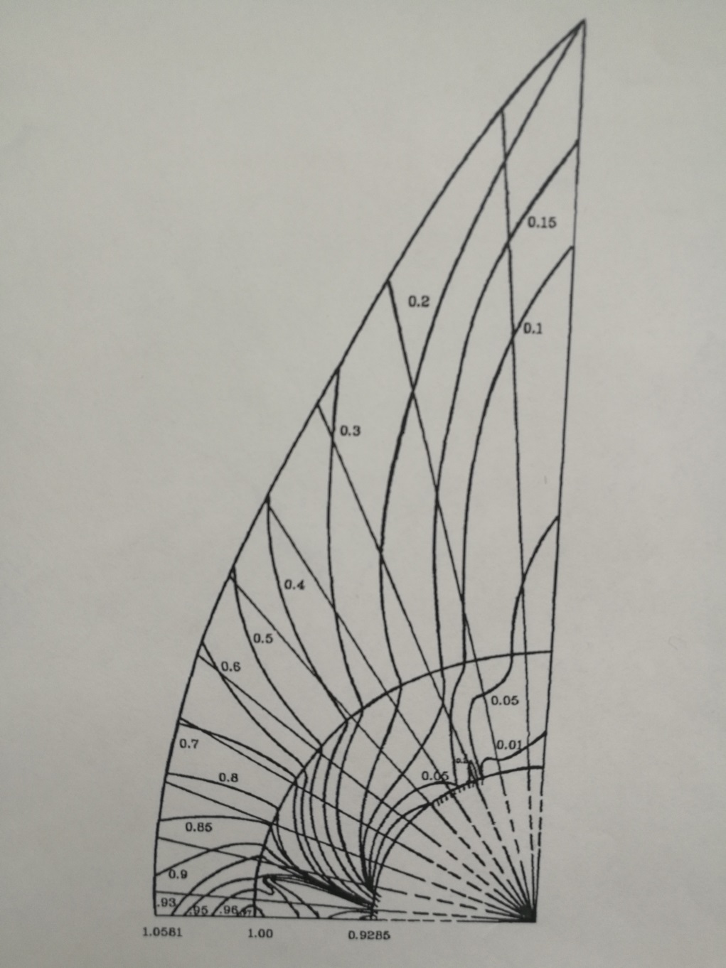

Slide 6
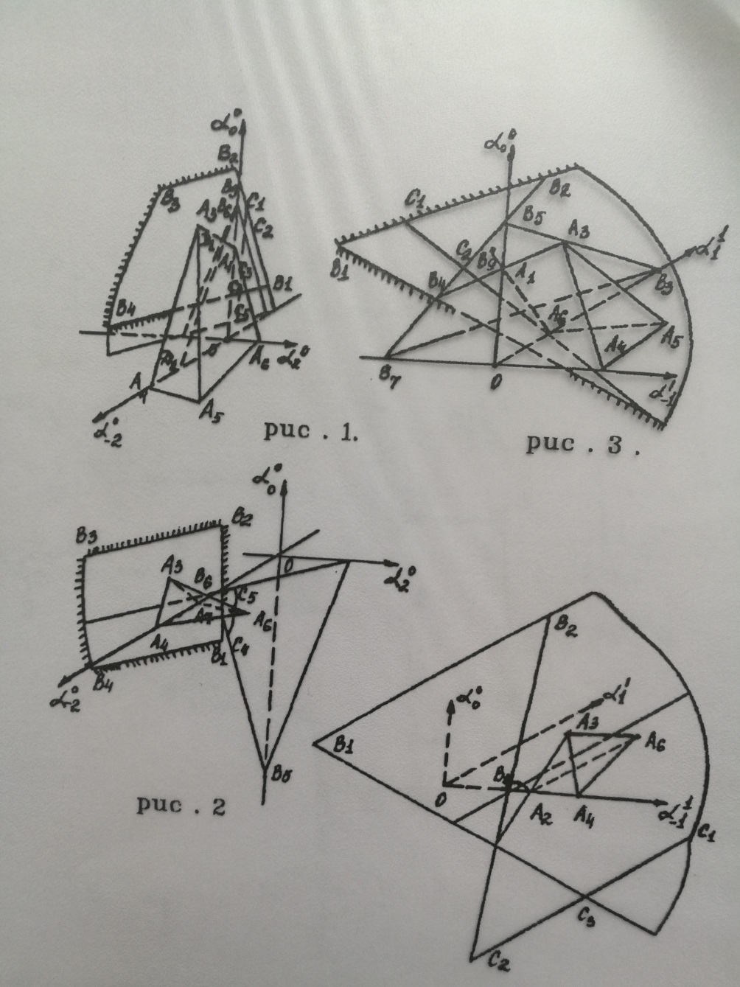

Slide 7
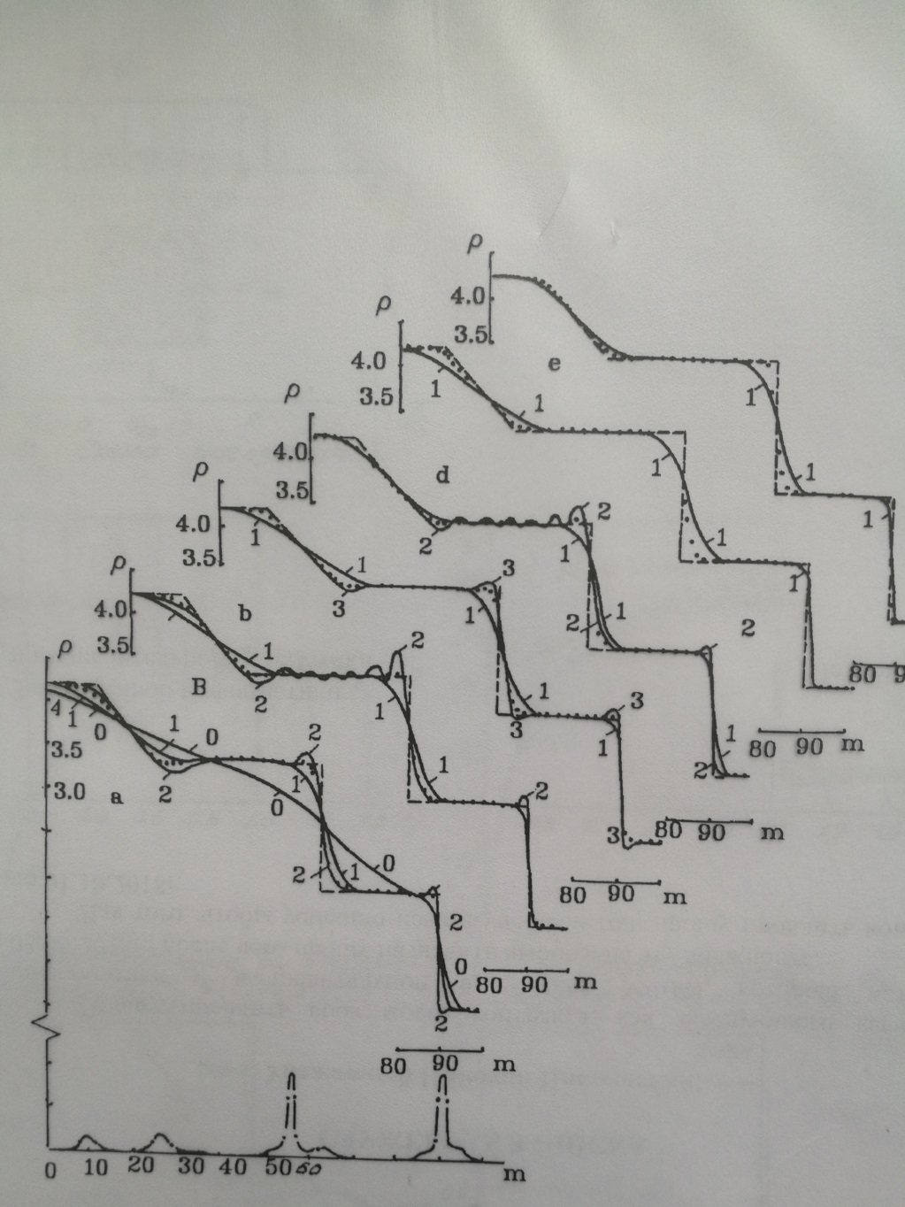

Slide 8
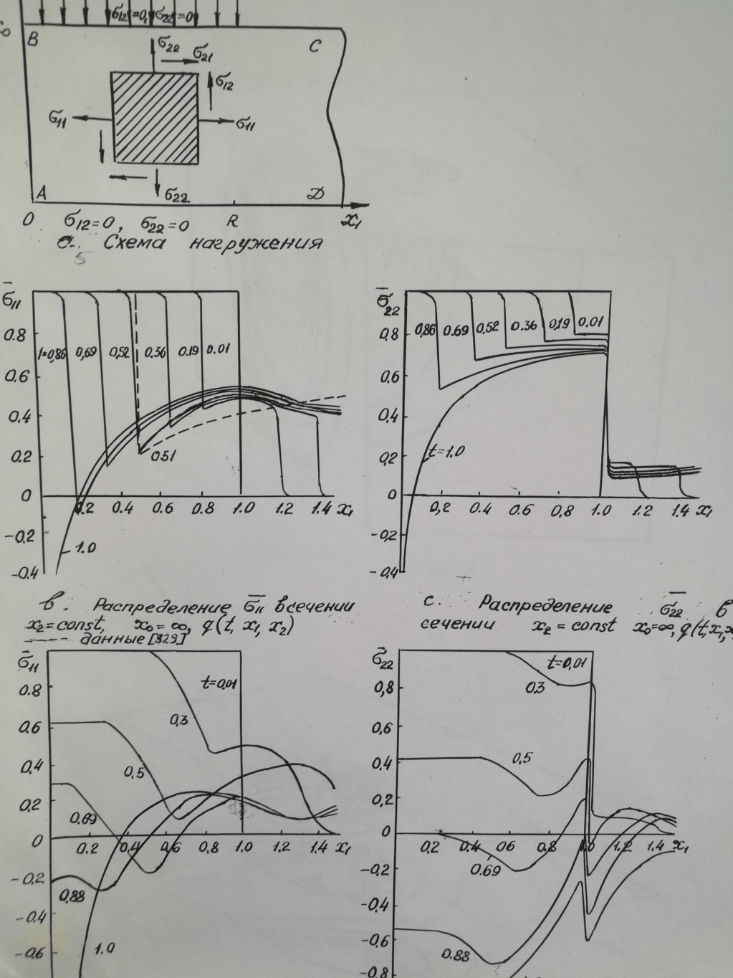

Slide 9
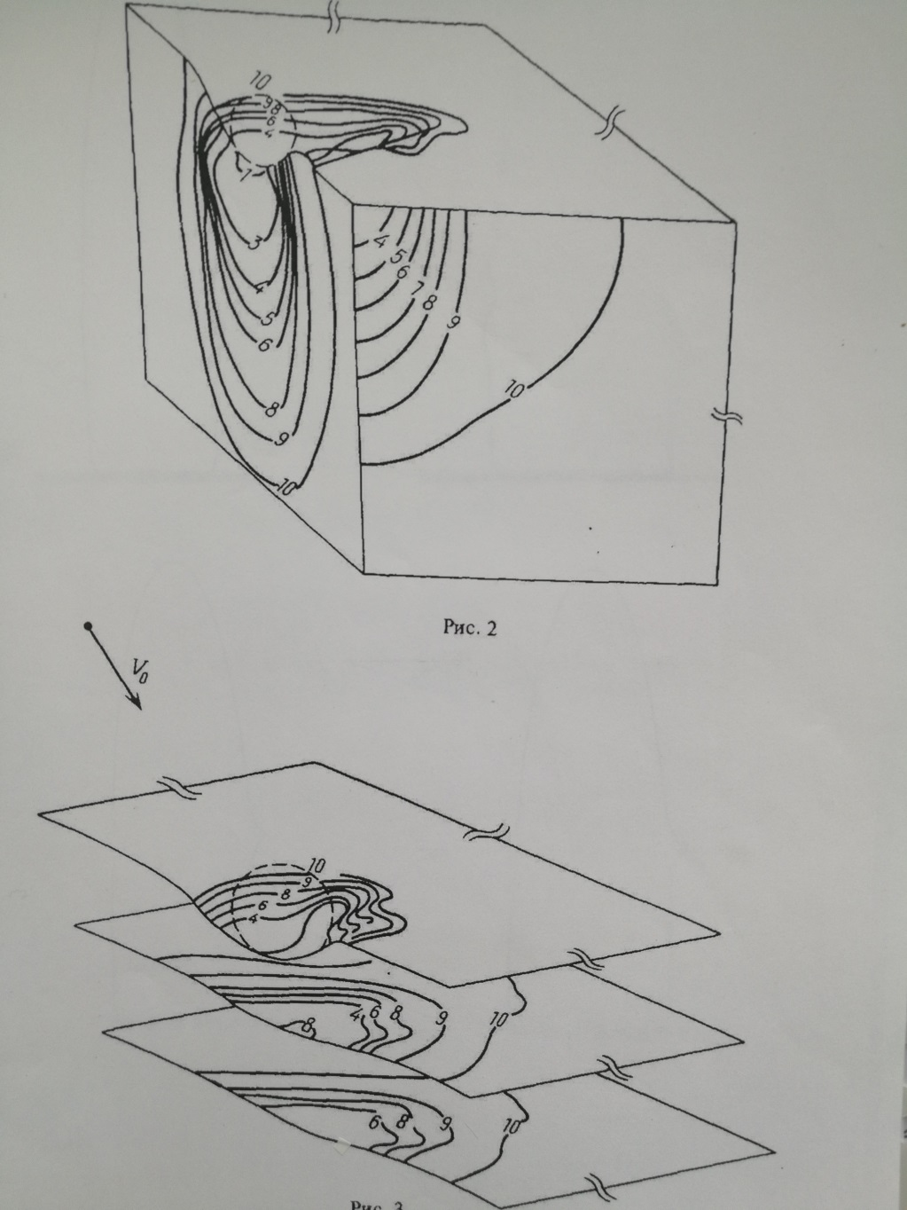

Slide 10
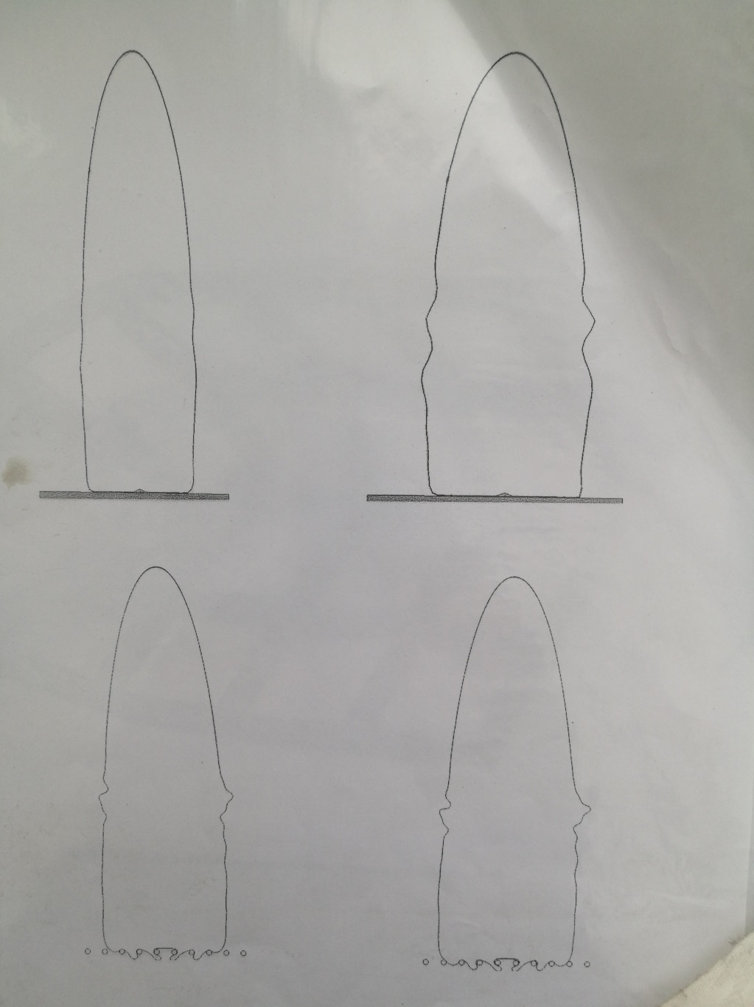

Slide 11
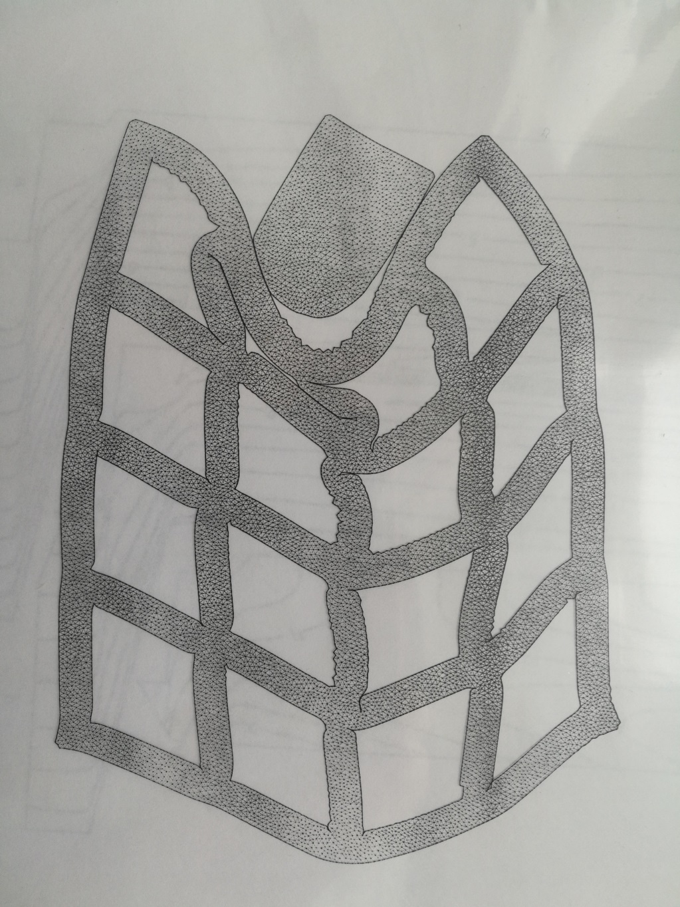

Slide 12
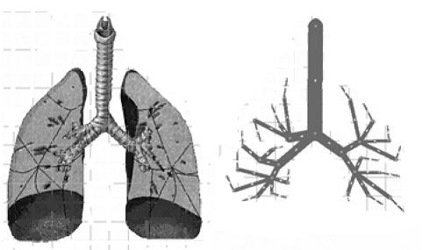
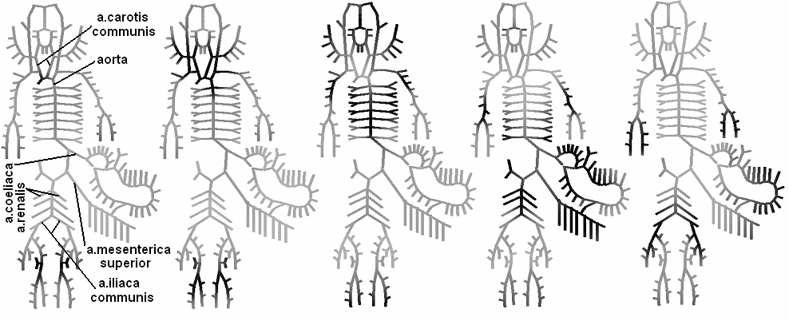
Modeling on graphs
blood flow
respiratory system

Slide 13
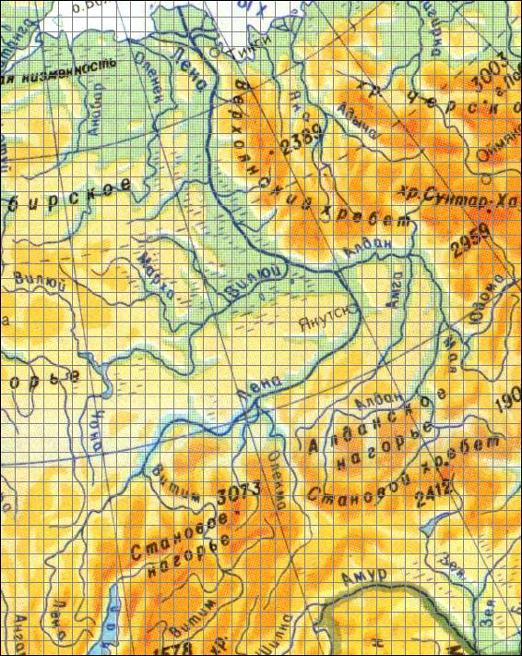
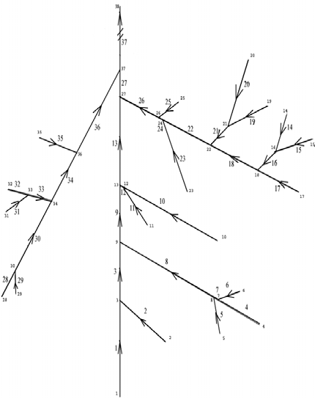
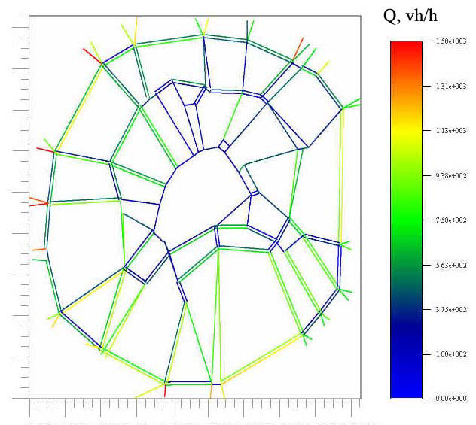
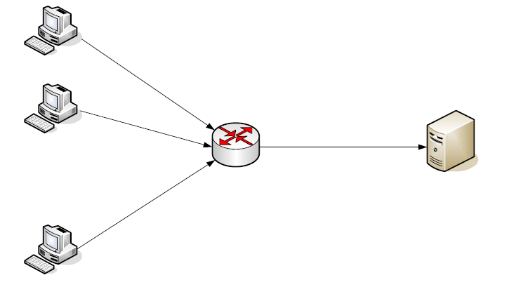
Modeling on graphs
flooding and transfer of pollution in branched river basins
traffic in metropolitan areas
information flows in regional electric networks

Slide 14
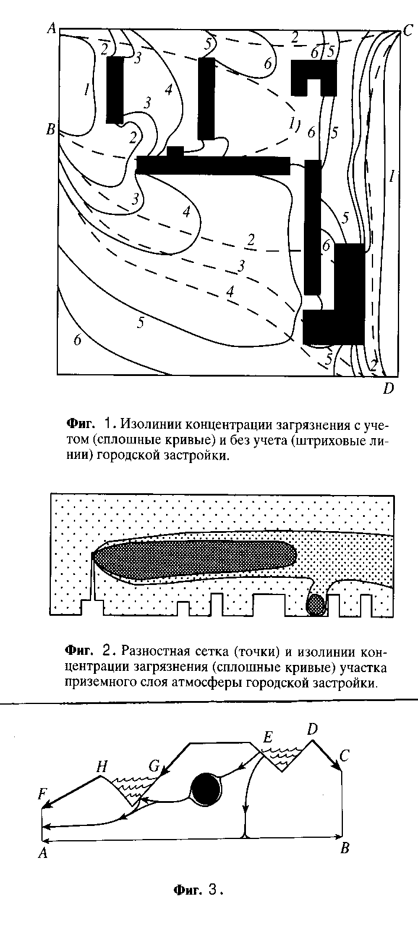
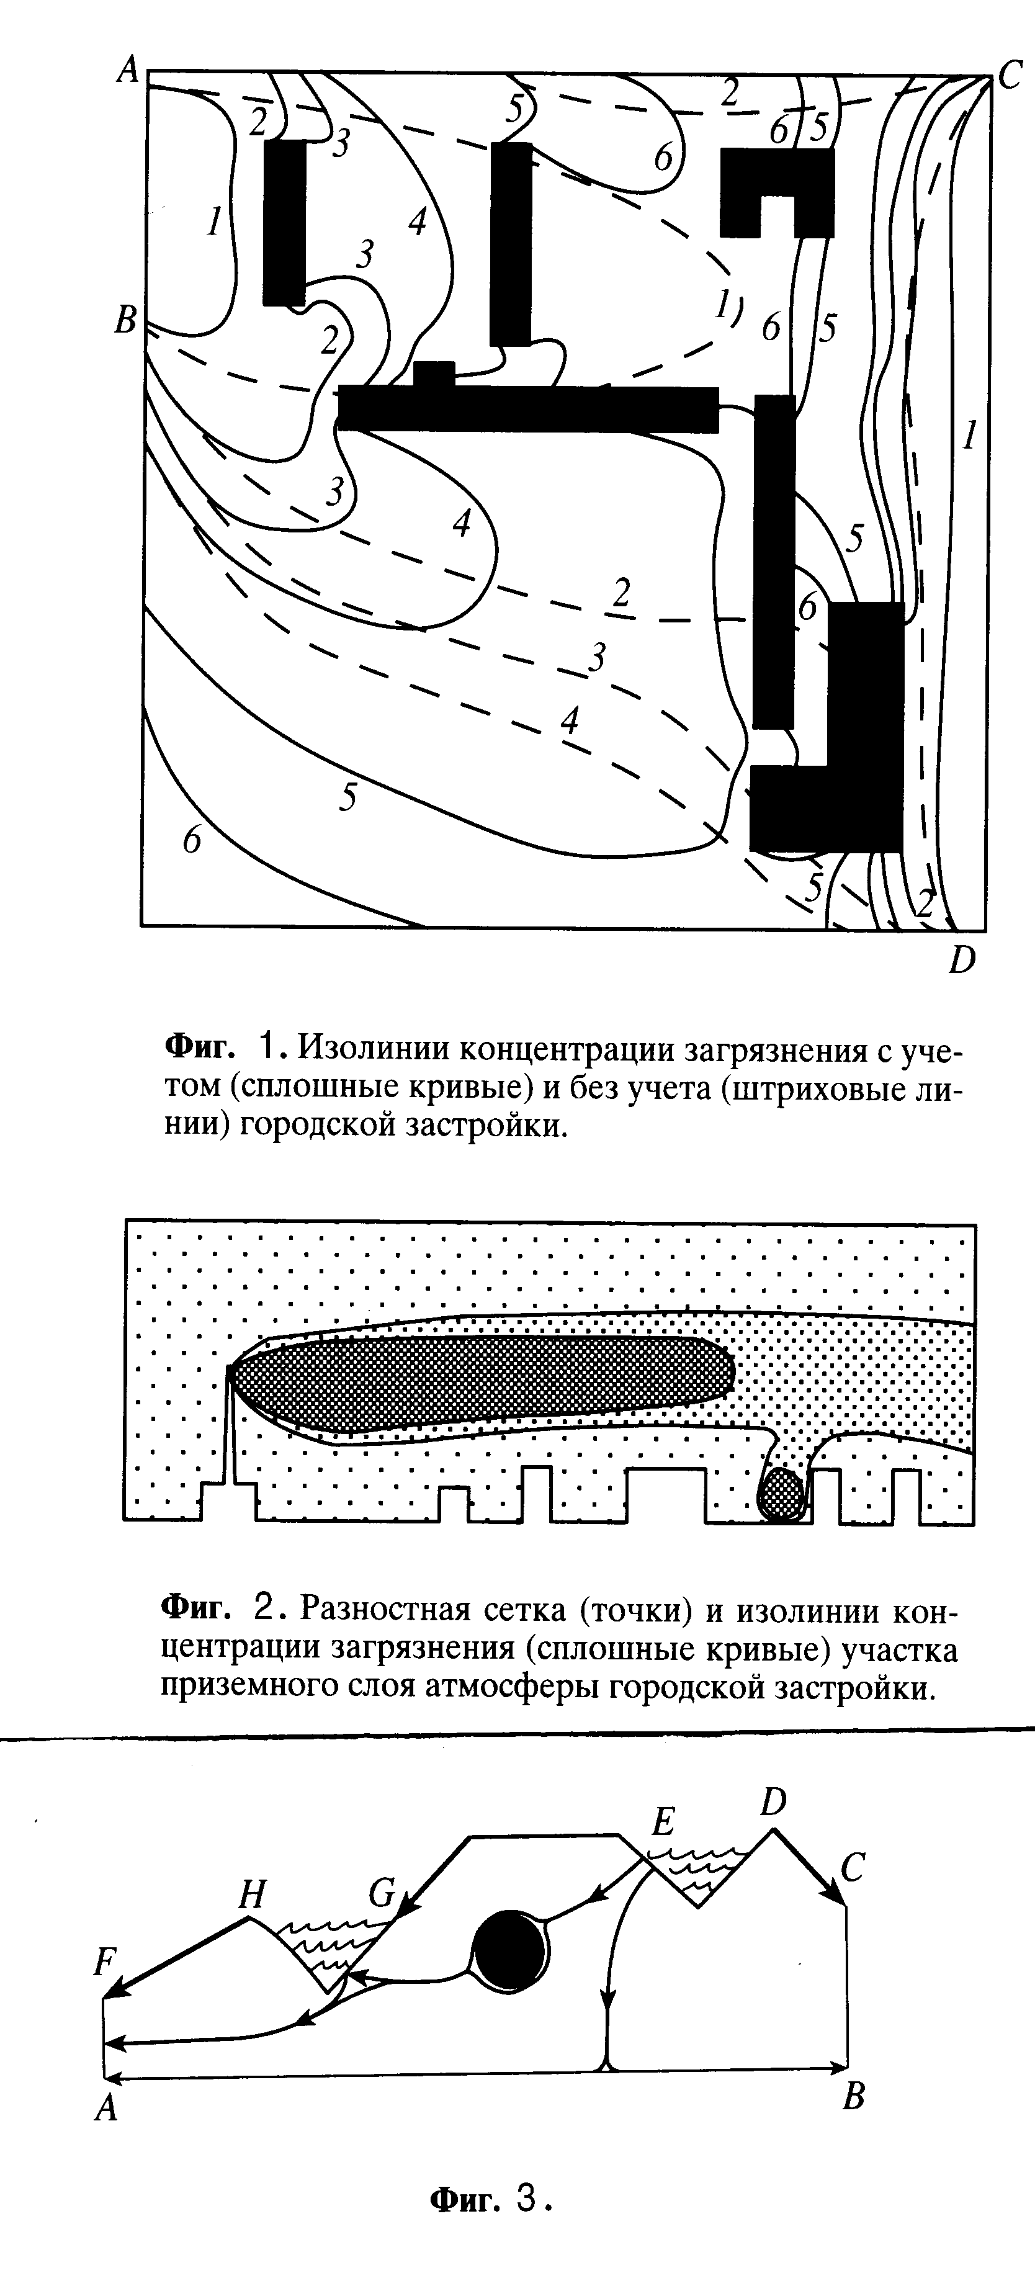
Distribution of atmospheric pollution
elliptic equations and systems on nonstructured (chaotic) grids
positively determined Friedrichs schemes

Slide 15
Cataract removal
Surgical instruments:
Laser needle (heat source)
Ultrasonic needle (stress source)
Muscle
Sclera
Crystalline
Anterior chamber
Heat source in laser case or stress source in ultrasonic case
Vitreous body

Slide 16

Cataract removal
Laser impulse. Velocity magnitude

Slide 17

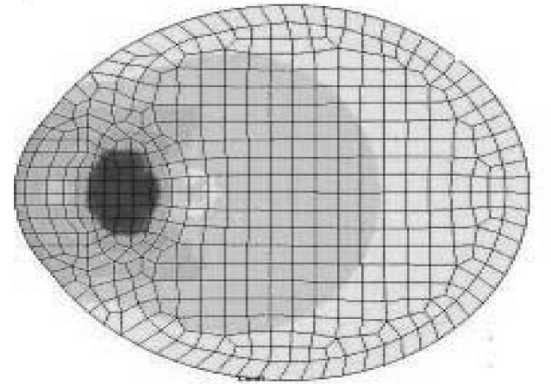
Cataract removal
GCM
FEM

Slide 18
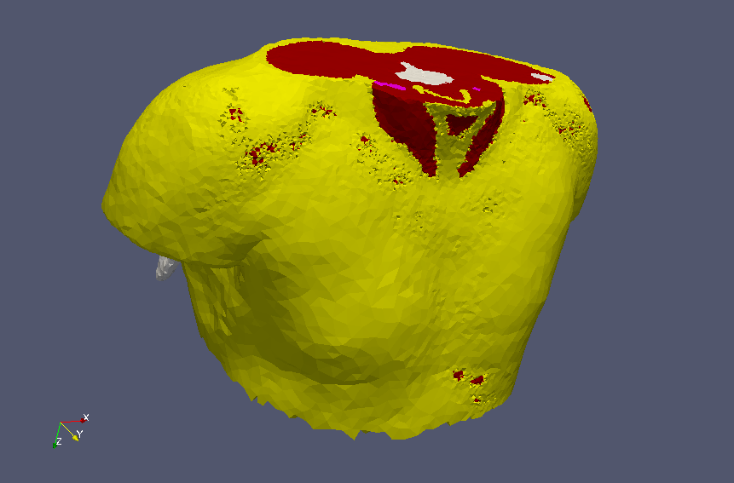
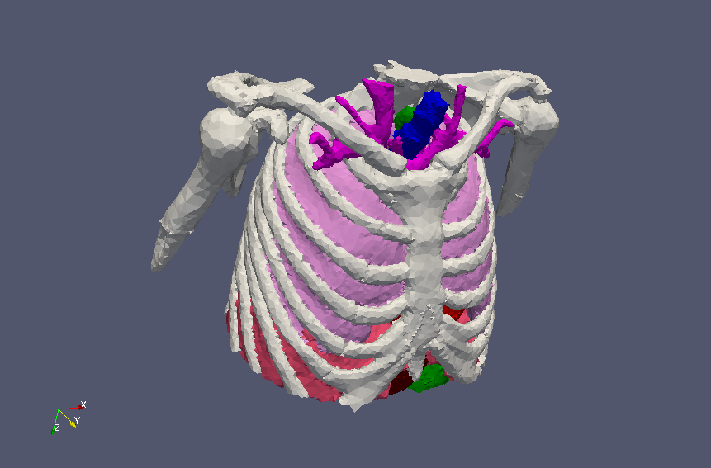
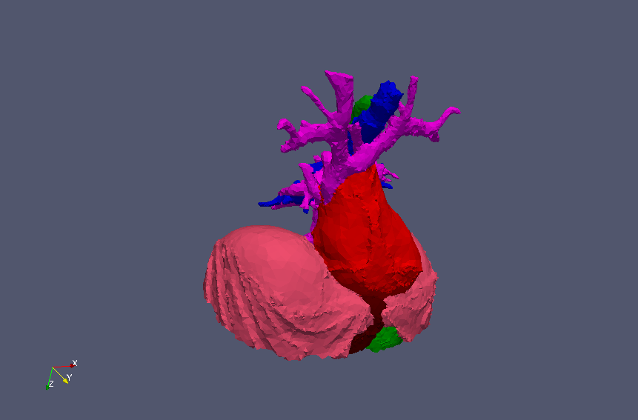
Torso impact
Meshes are provided by
Professor Y.V. Vassilevski
research team
Tissues in the model:
Fat
Muscles
Bones
Diaphragm
Liver
Digestive
Trachea
Heart and vessels

Slide 19
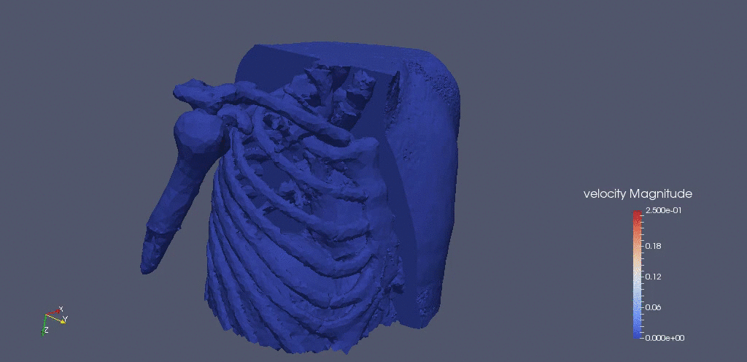
Torso impact

Slide 20
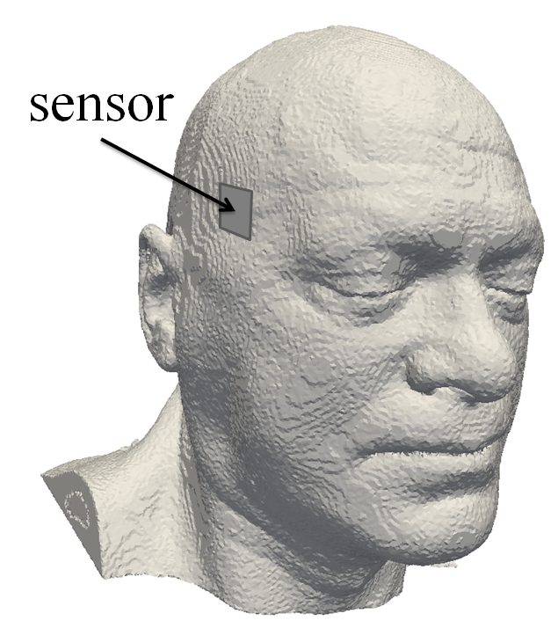
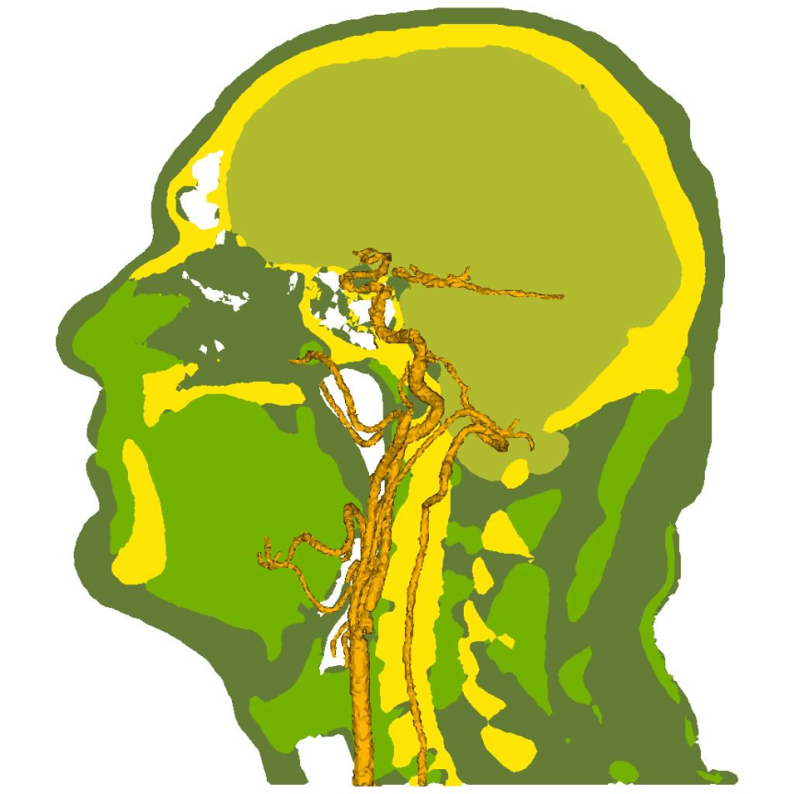
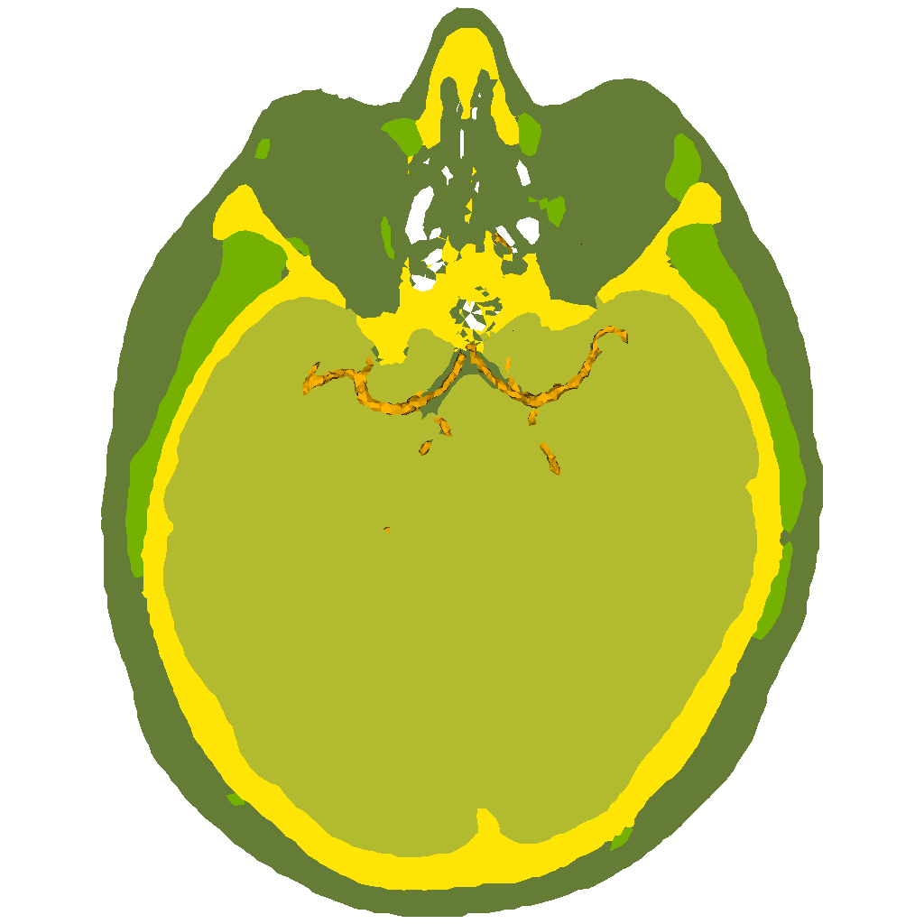
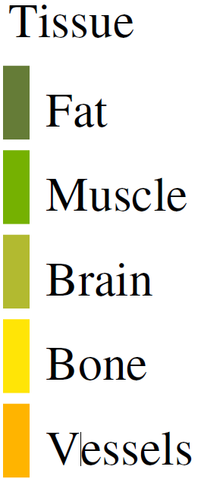
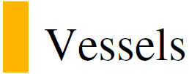
Transcranial ultrasound

Slide 21
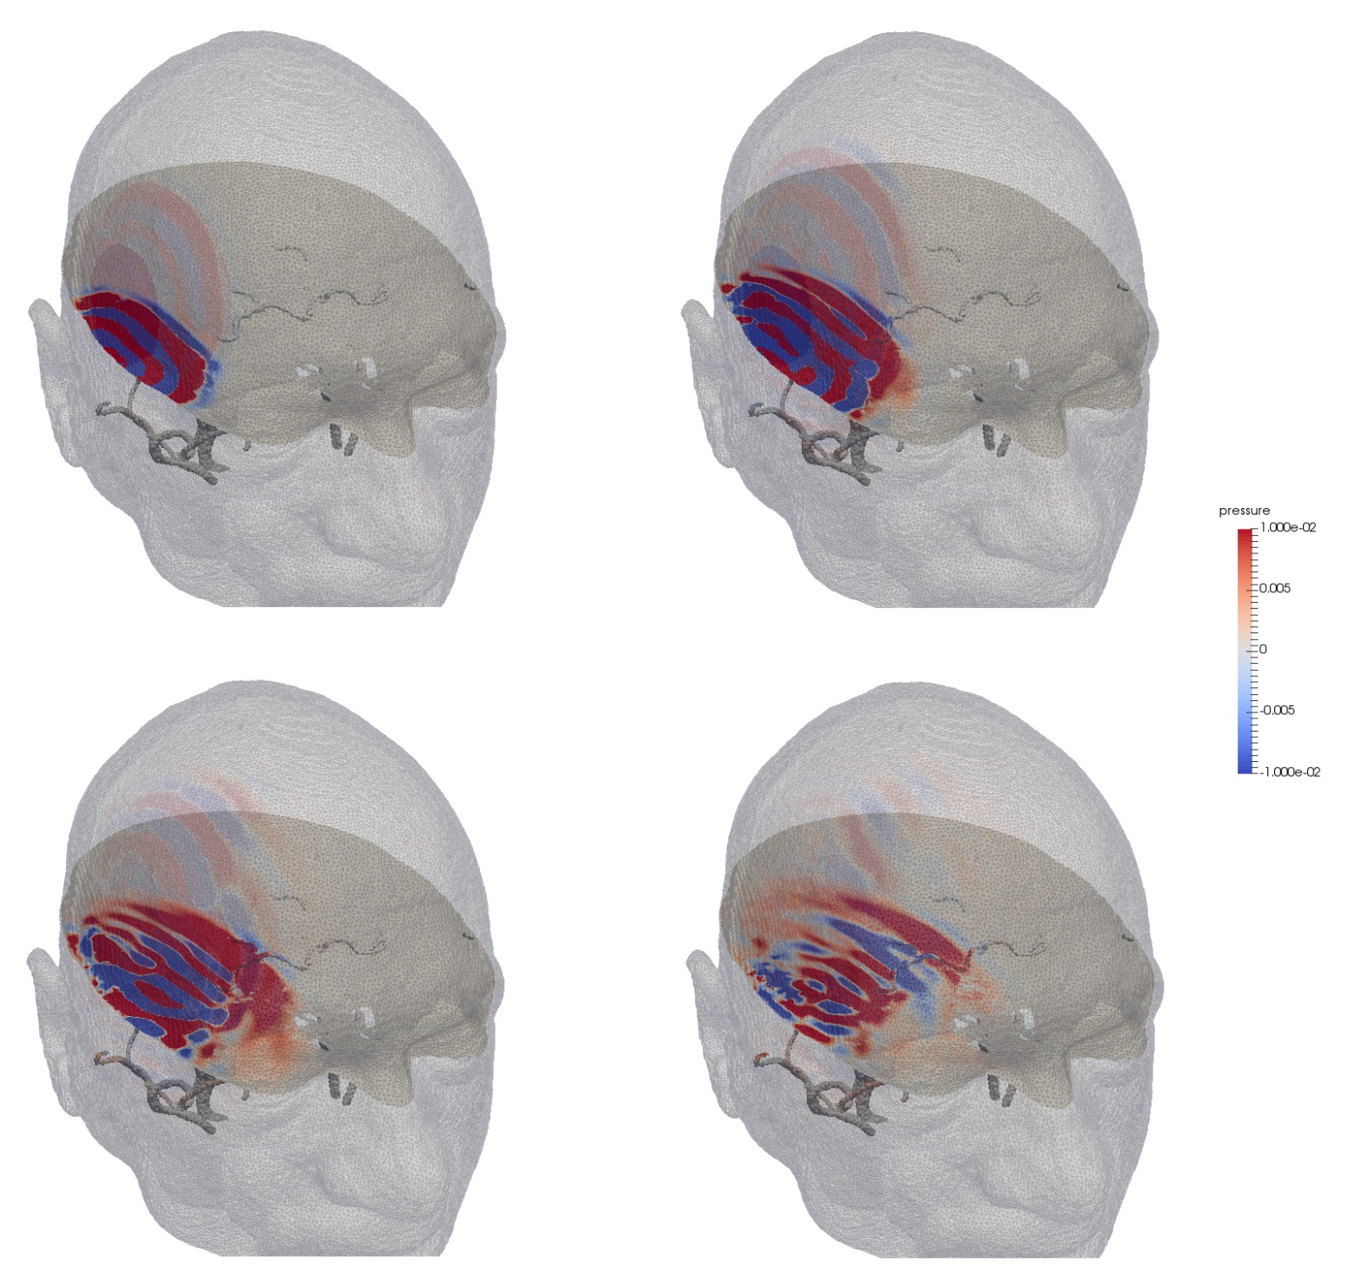
Transcranial ultrasound

Slide 22
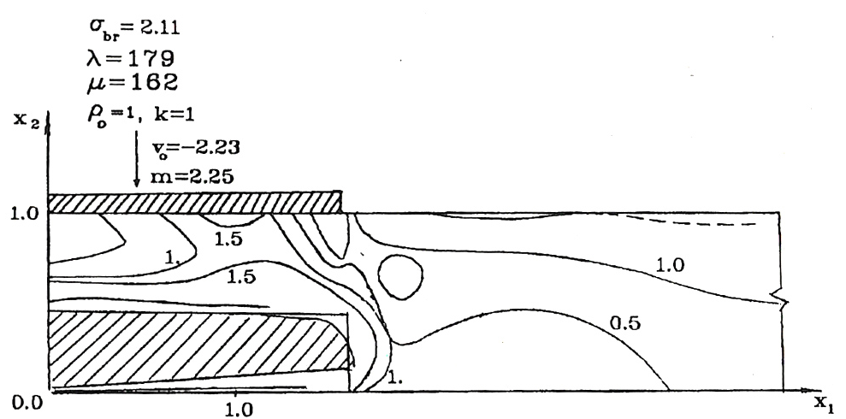
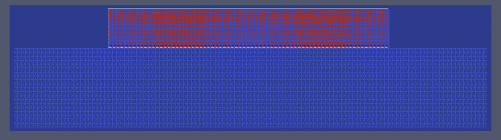
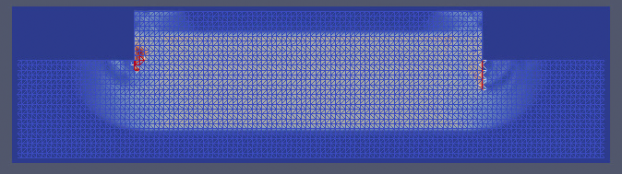
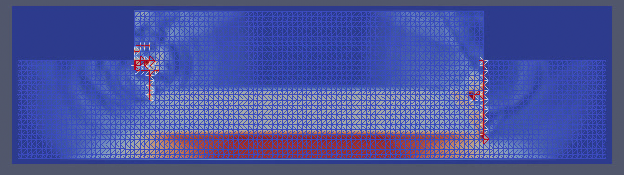
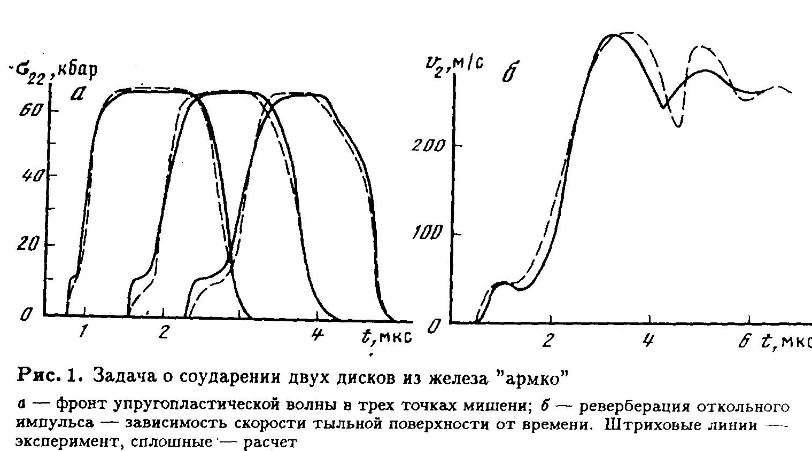
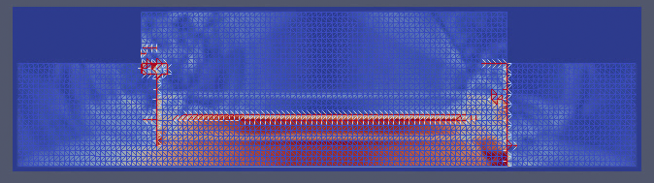
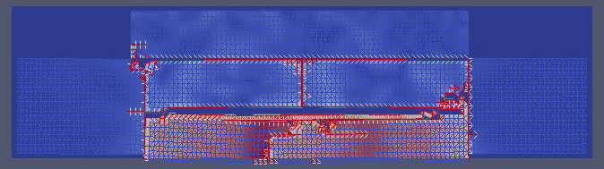
Rear break-off

Slide 23
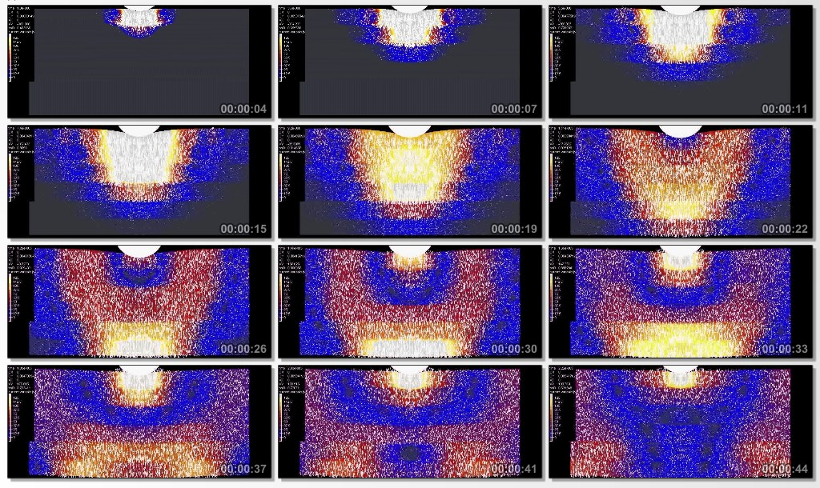
Multilayer glass

Slide 24
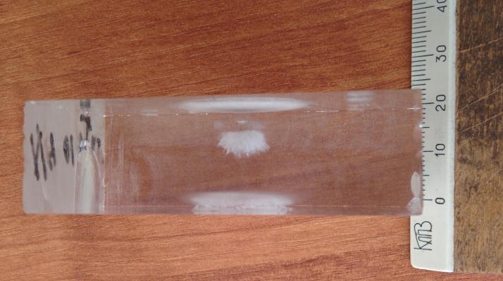
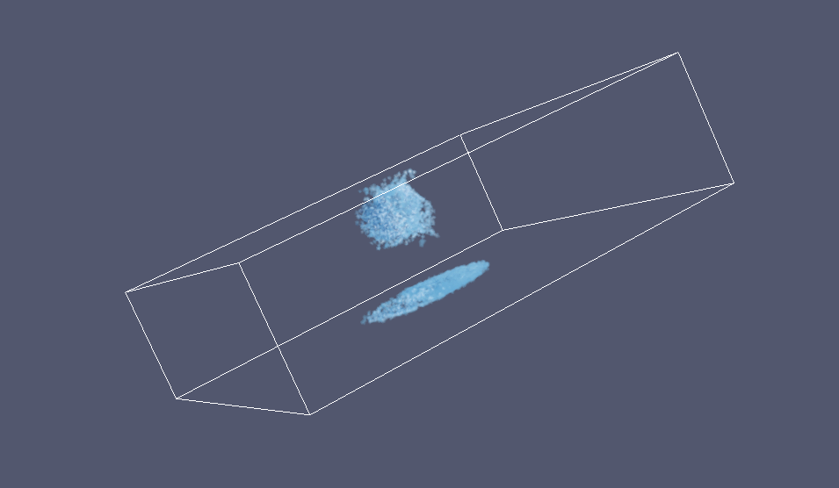
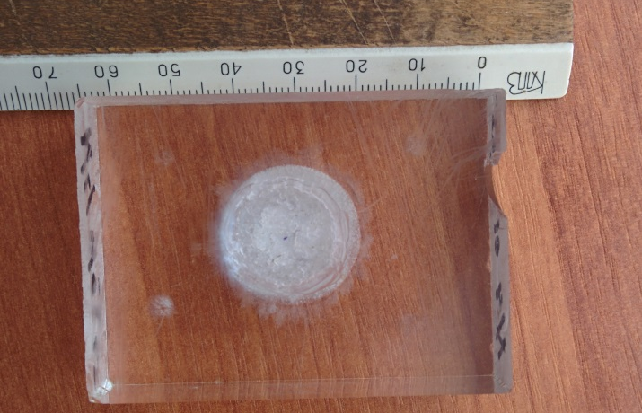
Glass destruction by laser pulse
New method of the polymeric material properties experimental investigation under powerful energy flux impact / B.A. Demidov, V.P. Efremov, Yu.G. Kalinin et al. // Proceedings of XXX International Conference on Interaction of Intense Energy Fluxes with Matter. – Journal of Physics: Conference Series (JPCS), 2015.
Notes:
При моделировании хрупкого разрушения стекла под воздействием лазерного излучения были получены результаты, качественно соответствующие результатам эксперимента.

Slide 25
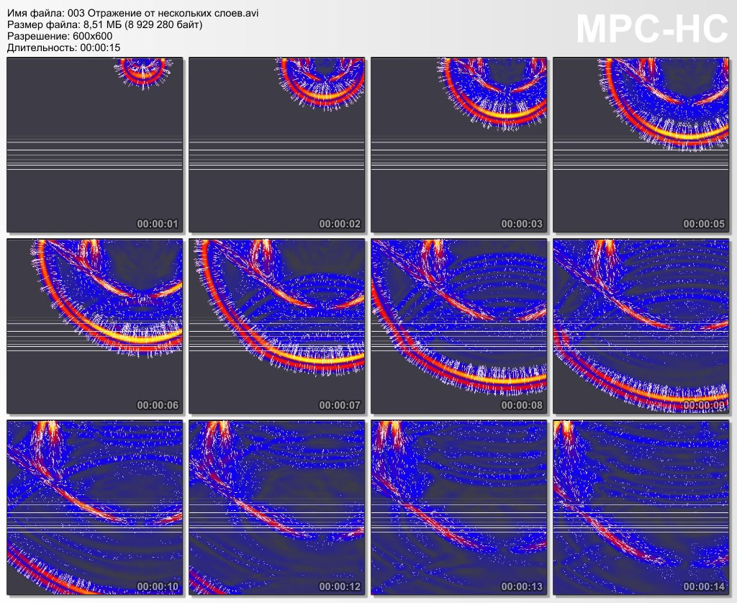
Seismics: multilayer area

Slide 26
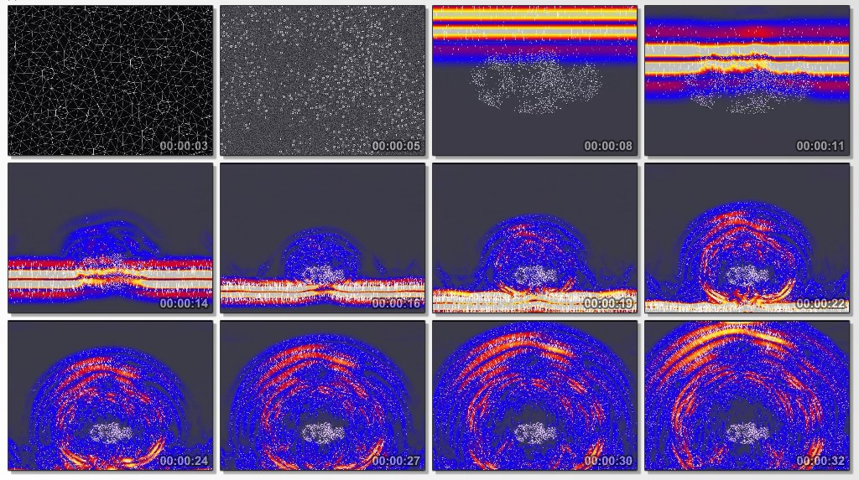
Seismics: cracks/caverns cluster

Slide 27
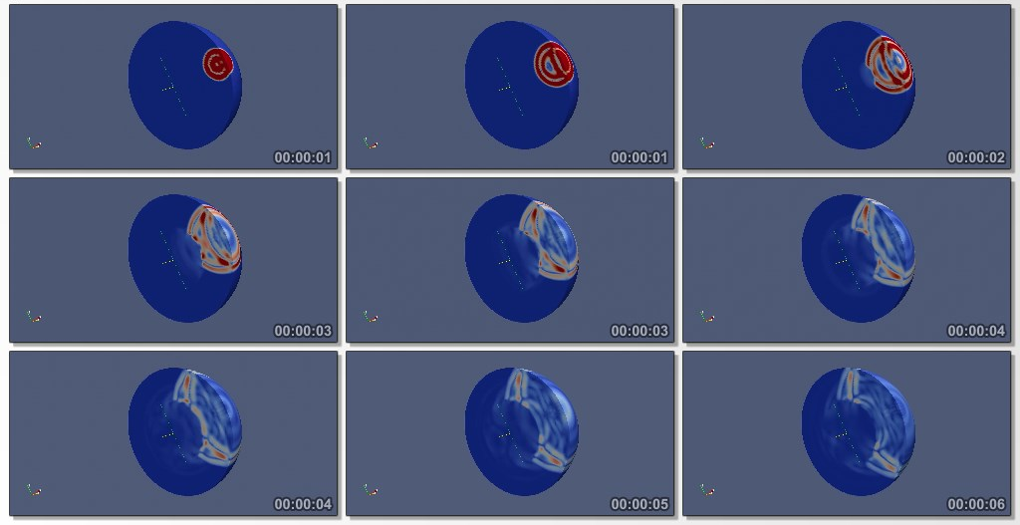
Seismics: planetary scale

Slide 28
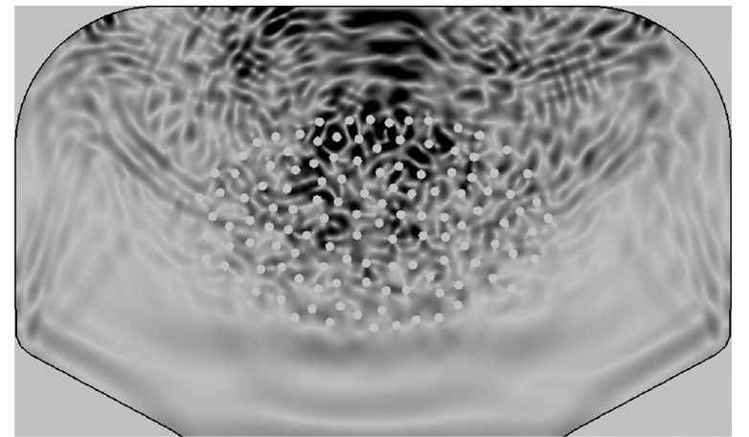
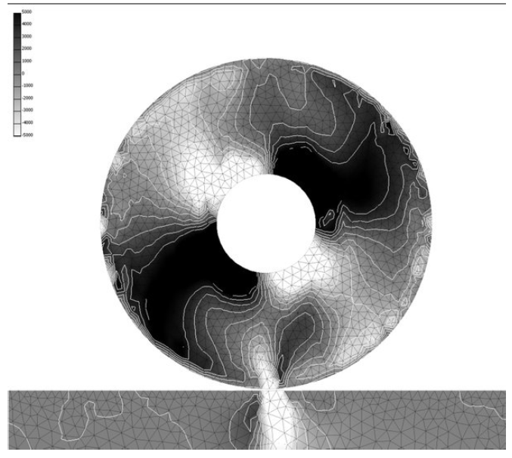
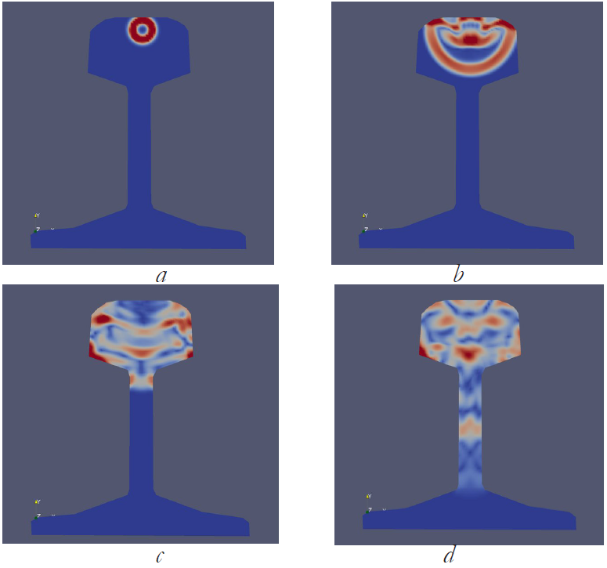
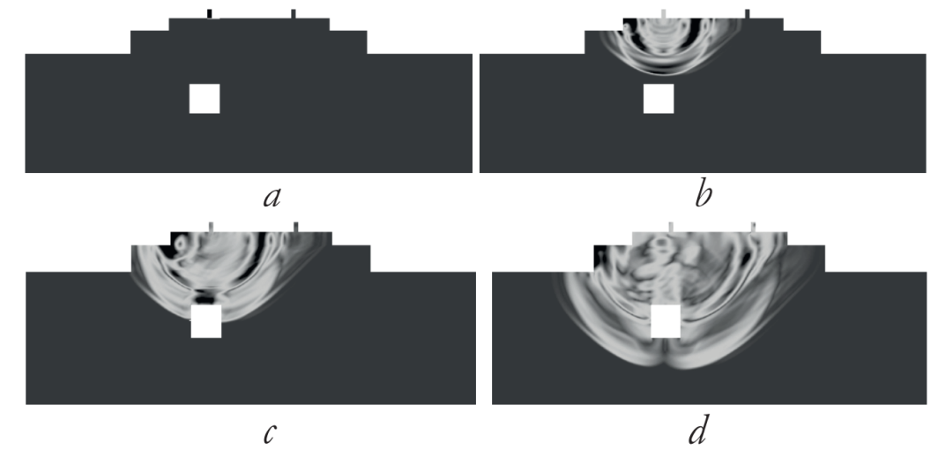
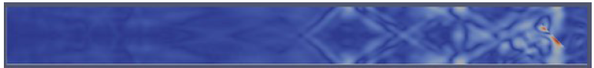
Russian Railways

Slide 29
Biography
more than 40 projects under scientific agreements with leading scientific and industrial organizations of the country
more than 8 grants of the RFBR, grants from INTAS, the International Science Center (ISTC),
projects of fundamental research of the Presidium of the Russian Academy of Sciences,
a grant from the Ministry of Education of the Russian Federation, participated in
grants "Leading Scientific School", etc.

Slide 30
Academician of the Russian Academy of Sciences Kholodov Alexander Sergeevich In Memoriam

